Slide 1
Component diagram

Slide 2
Component Diagram
Component diagram is a special kind of diagram in UML.
The purpose is also different from all other diagrams discussed so far.
It does not describe the functionality of the system but it describes the components used to make those functionalities.
Use component diagrams to model the static implementation view of a system.
This involves modeling the physical things that reside on a node, such as executables, libraries, tables, files, and documents.

Slide 3
Component Diagram
So the purpose of the component diagram can be summarized as:
Visualize the components of a system.
Construct executables by using forward and reverse engineering.
Describe the organization and relationships of the components.

Slide 4
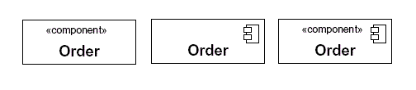


Component Diagram Notation
Components are shown as rectangles with two tabs at the upper left
Dashed arrows indicate dependencies
Circle and solid line indicates an interface to the component

Slide 5
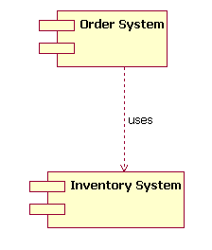


Slide 6
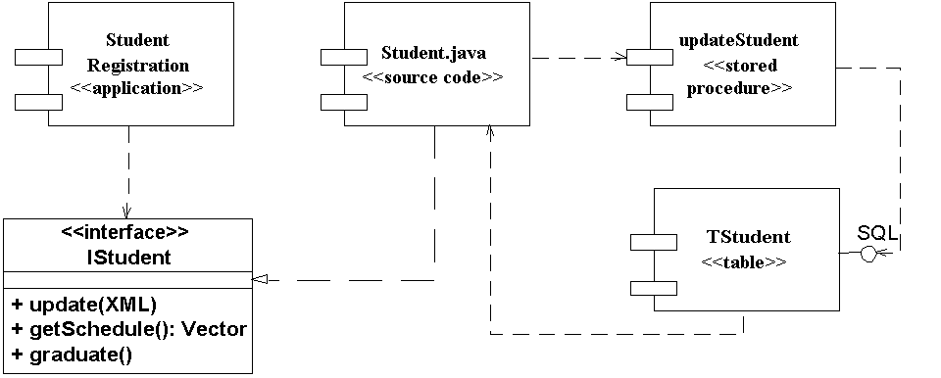
Sample interfaces

Slide 7
Component Diagram
signal.h
signal.h
signal.h
version = 3.5
version = 4.0
version = 4.1
“parent”
“parent”
signal.cpp
interp.cpp
version = 4.1
irq.h
device.cpp

Slide 8
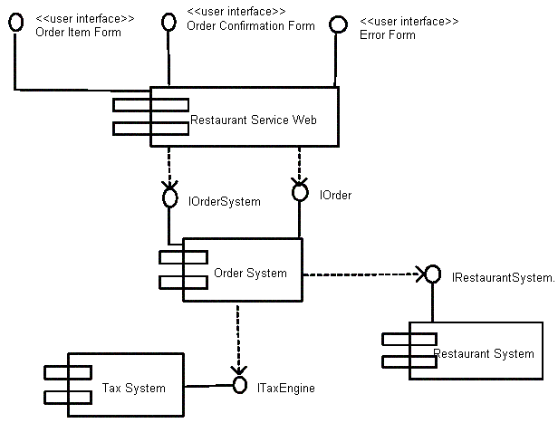
Component Example - Linking
Linking components with dependencies

Slide 9
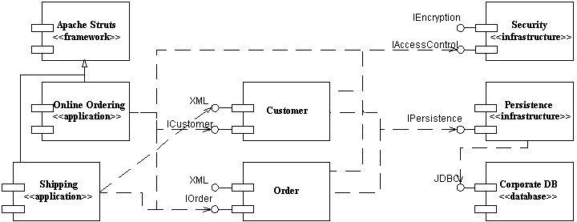
Example Component Diagram
Notes:
As you can see in Figure 1 components are modeled as rectangles with two smaller rectangles jutting out from the left-hand side. Components realize one or more interfaces, modeled using the lollipop notation in Figure 1, and may have dependencies on other components – as you can see the Persistence component has a dependency on the Corporate DB component.

Slide 10
Component Diagram
executable
find.html
Find.exe
page
Index.html
Comp1.dll
Comp2.dll
library
Notes:
Short for Dynamic Link Library, a library of executable functions or data that can be used by a Windows application. Typically, a DLL provides one or more particular functions and a program accesses the functions by creating either a static or dynamic link to the DLL. A static link remains constant during program execution while a dynamic link is created by the program as needed. DLLs can also contain just data. DLL files usually end with the extension .dll,.exe., drv, or .fon.
A DLL can be used by several applications at the same time. Some DLLs are provided with the Windows operating system and available for any Windows application. Other DLLs are written for a particular application and are loaded with the application.

Slide 11
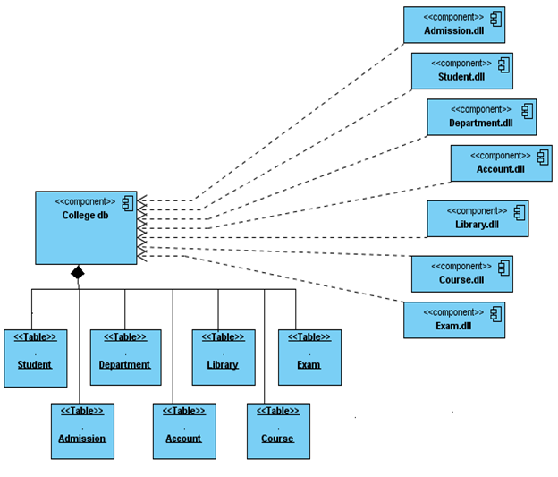
Component diagram for College Intranet

Slide 12
Deployment Diagrams
Shows the physical architecture of the hardware and software of the deployed system.
Nodes
Typically contain components or packages
Usually some kind of computational unit; e.g. machine or device (physical or logical)
Physical relationships among software and hardware in a delivered systems
Explains how a system interacts with the external environment

Slide 13
Deployment Diagrams
used for describing the hardware components where software components are deployed.
Component diagrams and deployment diagrams are closely related.
Component diagrams are used to describe the components and deployment diagrams shows how they are deployed in hardware.
UML is mainly designed to focus on software artifacts of a system. But these two diagrams are special diagrams used to focus on software components and hardware components.
So most of the UML diagrams are used to handle logical components but deployment diagrams are made to focus on hardware topology of a system.
Deployment diagrams are used by the system engineers.

Slide 14


Node
Nodes are model elements that represent the computational resources of a system, such as personal computers, sensors, printing devices, or servers.
Nodes can be interconnected, by using communication paths, to describe network structures.
A node has a name that describes the piece of hardware that it represents.

Slide 15
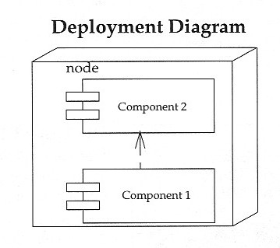
Deployment Diagrams – Notation and Example

Slide 16
A Deployment Diagram
Internet
node
Modem bank
<<processor>>
<<processor>>
connection
Caching server
Caching server
<<network>> local network
<<processor>>
<<processor>>
<<processor>>
<<processor>>
primary server
server
server
server
Notes:
A node, depicted as a three-dimensional box, represents a computational unit, typically a single piece of hardware, such as a computer, network router, mainframe, sensor, or personal digital assistant (PDA). Components, depicted as rectangles with two smaller rectangles jutting out from the left-hand side (the same notation used on UML Component diagrams), represent software artifacts such as file, framework, or domain component.

Slide 17
Modeling Client-Server Architecture
Identify nodes that represent system’s client and server processors
Highlight those devices that are essential to the behavior
E.g.: special devices (credit card readers, badge readers, special display devices)
Use stereotyping to visually distinguish

Slide 18
Client-Server System
Human resource system
2 pkgs: client, server
Client: 2 nodes
console and kiosk
stereotyped, distinguishable
Server: 2 nodes
caching server and server
Multiplicities are used
client
console
kiosk
server
2..*
4..*
<<processor>>
<<processor>>
Caching server
server
Deploys
Deploys
dbadmin.exe
tktmstr.exe
logexc.exe
Http.exe
rting.exe
Notes:
2.4 Apply Visual Stereotypes to Nodes
Figure 2 depicts nodes using visual stereotypes, for example the mobile PC is shown as a laptop and the databases are shown using traditional database drum notation. There are no standards for applying visual stereotypes on UML Deployment diagrams – the general rule of thumb is to use the most appropriate clip art that you can find.

Slide 19
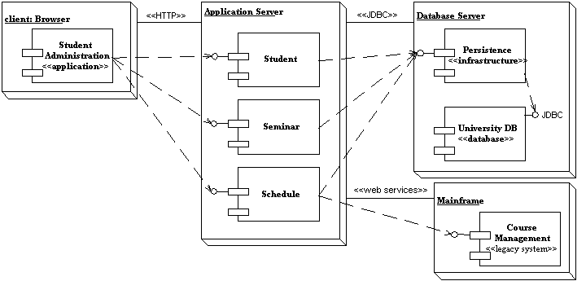
Sample Communication Links
Notes:
Communication associations support one or more communication protocols, each of which should be indicated by a UML stereotype. In Figure 1 you see that the HTTP, JDBC, and web services protocols are indicated using this approach. Table 1 provides a representative list of stereotypes for communication associations – your organization will want to develop its own specific standards.
Table 1. Common stereotypes for communication associations.
Stereotype Implication
Asynchronous An asynchronous connection, perhaps via a message bus or message queue.
HTTP HyperText Transport Protocol, an Internet protocol.
JDBC Java Database Connectivity, a Java API for database access.
ODBC Open Database Connectivity, a Microsoft API for database access.
RMI Remote Method Invocation, a Java communication protocol.
RPC Communication via remote procedure calls.
Synchronous A synchronous connect where the senders waits for a response from the receiver.
web services Communication is via Web Services protocols such as SOAP and UDDI

Slide 20
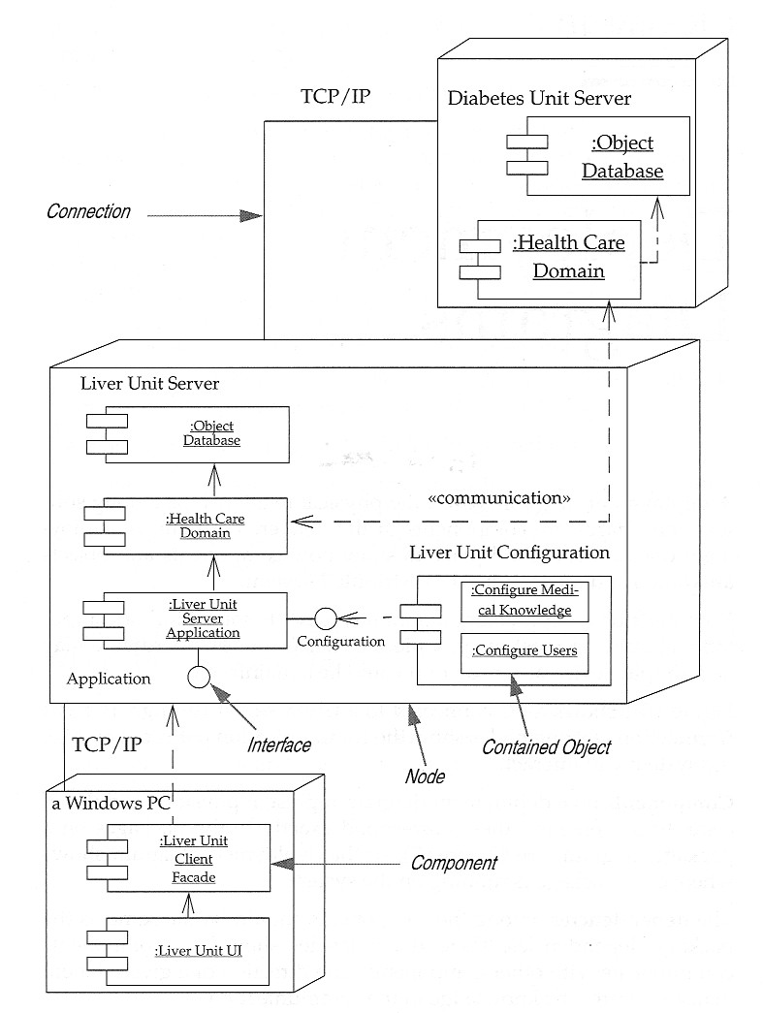
Deployment Diagrams – Notation and Example

Slide 21
Purpose of Deployment Diagrams:
Visualize hardware topology of a system.
Describe the hardware components used to deploy software components.
Describe runtime processing nodes..
To model embedded system.
To model hardware details of a distributed application.
Forward and reverse engineering.

Slide 22
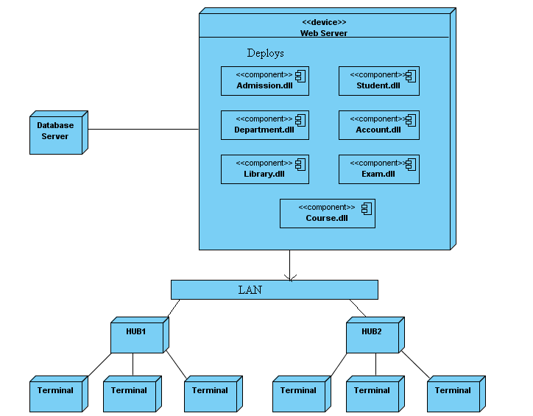
Deployment diagram for college intranet

